Slide 1


Chapter 2
Communication

Slide 2
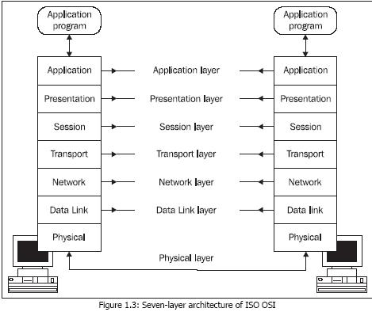
Layered Protocol
Layers, Interfaces, and protocols in OSI Model

Slide 3
OSI layers
Physical Layer:
Role: Deals with the physical connection between devices, defining hardware specifications like cables and connectors.
Example: Ethernet cables used for wired connections or Wi-Fi signals for wireless connections.
Data Link Layer:
Role: Responsible for node-to-node communication, error detection, and framing.
Example: Ethernet protocol, where devices on the same local network communicate using MAC (Media Access Control) addresses.

Slide 4
OSI layers
Network Layer:
Role: Handles routing and forwarding of data packets between devices across different networks.
Example: Internet Protocol (IP), which enables the routing of data across multiple networks on the internet.
Transport Layer:
Role: Ensures end-to-end communication, error detection, and flow control between devices.
Example: Transmission Control Protocol (TCP) ensures reliable and ordered delivery of data between applications.

Slide 5
OSI layers
Session Layer:
Role: Manages sessions (connections) between applications on different devices.
Example: NetBIOS (Network Basic Input/Output System) in Windows networks manages sessions between devices for file and print sharing.
Presentation Layer:
Role: Translates data between the application layer and lower layers, ensuring compatibility between different systems.
Example: JPEG or GIF image compression standards for presenting images across different platforms.

Slide 6
OSI layers
Application Layer:
Role: Provides network services directly to end-users and applications.
Example: Hypertext Transfer Protocol (HTTP) used by web browsers to communicate with web servers, facilitating the transfer of web pages.
Example: sending an email
Physical Layer: involves the actual hardware components such as your computer, network cables, and the physical infrastructure of the internet.
Data Link Layer: manages the communication between your computer and the local router, ensuring that data is transmitted without errors.

Slide 7
OSI layers
Network Layer: IP addresses are used by the network layer to route your email data packets from your local network to the recipient's network through the internet.
Transport Layer: represented by protocols like TCP, manages the reliable delivery of email data between your computer and the email server.
Session Layer: assists in establishing and maintaining a secure connection between your email client (e.g., Outlook or Gmail) and the email server.

Slide 8
OSI layers
Presentation Layer: Data encryption and encoding may be applied at the presentation layer to secure the email content during transmission.
Application Layer: involves your email client software, such as Microsoft Outlook or Gmail, through which you compose, send, and receive emails.
Summary of Sending an Email:
When you send an email, the OSI model is at work. The physical layer involves your computer and network hardware, the data link layer manages communication with the local router, the network layer routes the email data across the internet, the transport layer ensures reliable email delivery, the session layer establishes a secure connection, the presentation layer encrypts and encodes data, and the application layer encompasses your email client.

Slide 9
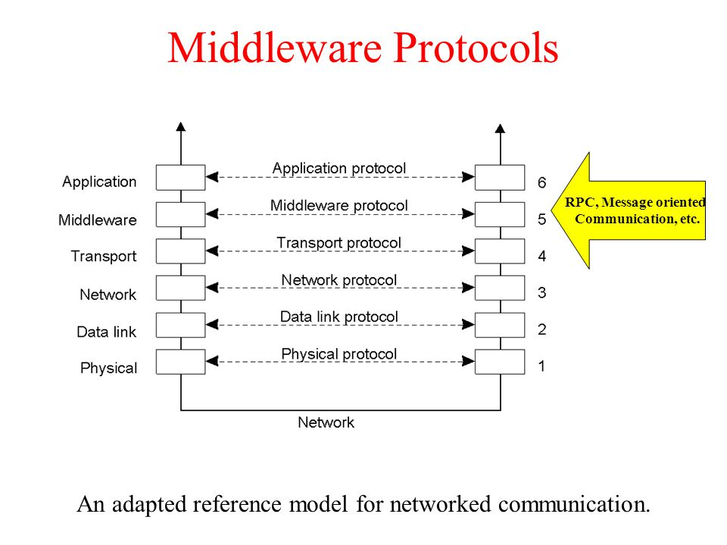
Remote Procedure Call

Slide 10
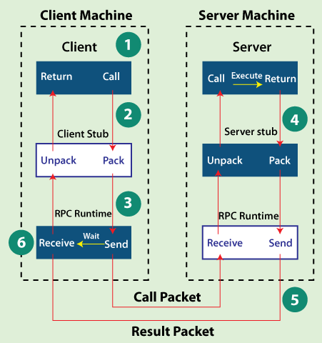
Remote Procedure Call
Remote procedure calls simplify the process of communication between programs running on different machines, making it as seamless as if they were right next to each other.
Remote Procedure Call

Slide 11
Remote Procedure Call
Client: The client is the program that initiates the RPC. It needs a specific service or function that is not available locally, so it makes a call to a procedure as if it were local.
Stub (Client-side and Server-side): The client-side stub and server-side stub are intermediary components that handle the communication between the client and server.
Client-side Stub: It takes the client's request and packages it into a format suitable for transmission over the network. This includes converting parameters into a message that can be sent to the server.

Slide 12
Remote Procedure Call
Server-side Stub: On the server side, the stub receives the message, unpacks it, and invokes the actual procedure or function. It acts as a bridge between the network communication and the actual server-side implementation.
Marshalling/Unmarshalling: Marshalling is the process of converting data into a format suitable for transmission over the network. Unmarshalling is the reverse process, where the received data is converted back into a usable format.
Transport Layer: This layer is responsible for the actual transmission of data between the client and server. It ensures that the marshalled data is sent securely and reliably.

Slide 13
Remote Procedure Call
Server: The server is the program that hosts the actual procedure or service that the client is requesting. It receives the request, processes it, and sends back the results.
In a technical sense, RPC is a way for one program to request a service from another program on a remote machine, as if they were both local.

Slide 14
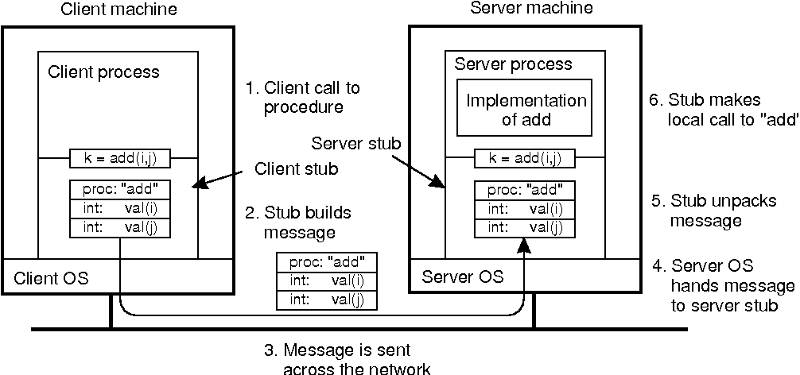
Remote Procedure Call (Parameter Passing)
Parameter passing is the mechanism by which data is sent from the client to the server, allowing the server to execute the requested procedure with the provided parameters.
Remote Procedure Call using Parameter Passing

Slide 15
Remote Procedure Call (Limitations)
Latency and Performance:
Imagine you're calling a remote procedure to fetch real-time stock prices for a financial application. The network latency can significantly impact the responsiveness of the application, leading to delays in updating the stock prices.
Failure Handling:
In a distributed system, if the network or server fails during an RPC, the client might not get a response. Handling such failures robustly and ensuring data consistency becomes challenging.
For instance, an online shopping cart trying to confirm a purchase may face difficulties if the payment server is temporarily.

Slide 16
Remote Procedure Call (Limitations)
Security Concerns:
Transmitting sensitive data over the network during an RPC raises security concerns.
If the communication is not adequately secured, there's a risk of data interception.
For instance, if an RPC is used for authenticating user credentials, an insecure channel may expose sensitive information.
Synchronous Nature:
RPCs are often synchronous, meaning the client waits for a response from the server. In scenarios where the server is performing resource-intensive tasks, this synchronous nature can lead to delays.

Slide 17
Remote Procedure Call (Limitations)
Compatibility Issues:
Different platforms or programming languages may interpret data formats differently.
If the client and server use incompatible data representations, it can lead to difficulties in parameter marshalling and unmarshalling.
Limited Language Support:
Some languages may not have native support for RPC, making it challenging to integrate RPC into applications written in those languages.
If a system predominantly uses a language without good RPC support, the adoption of RPC may be impractical.

